Slide 1

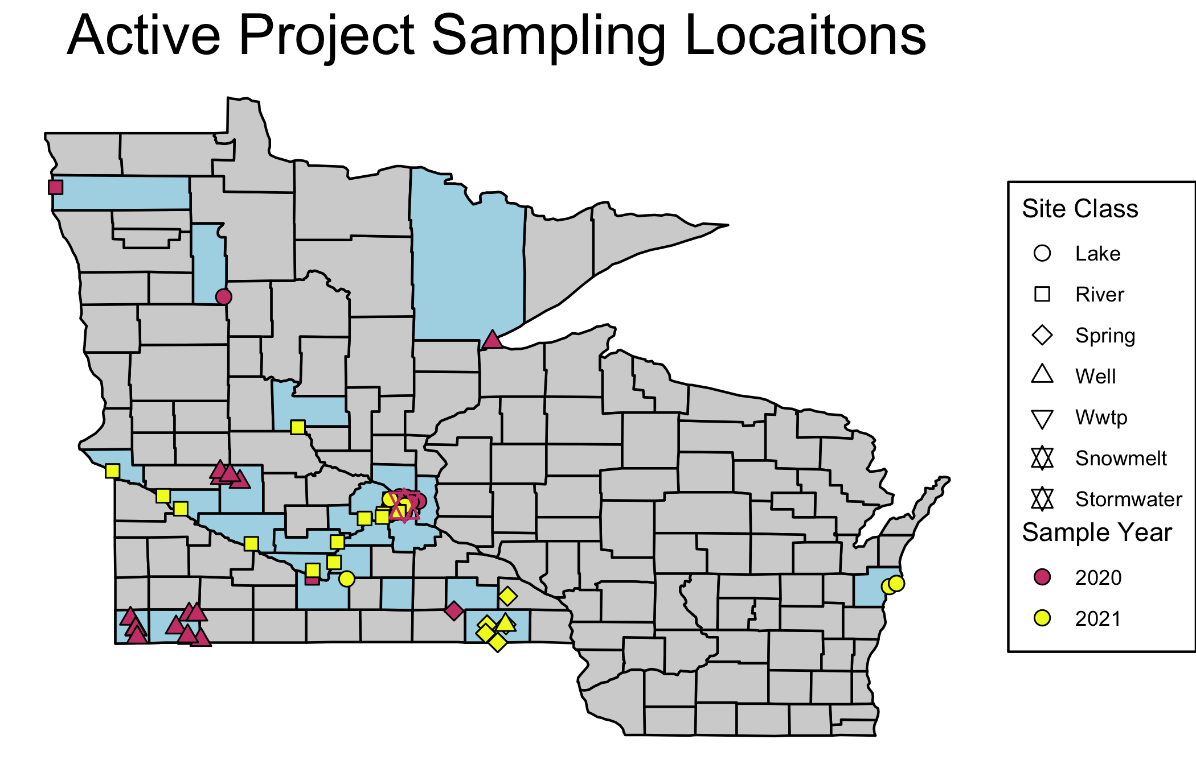


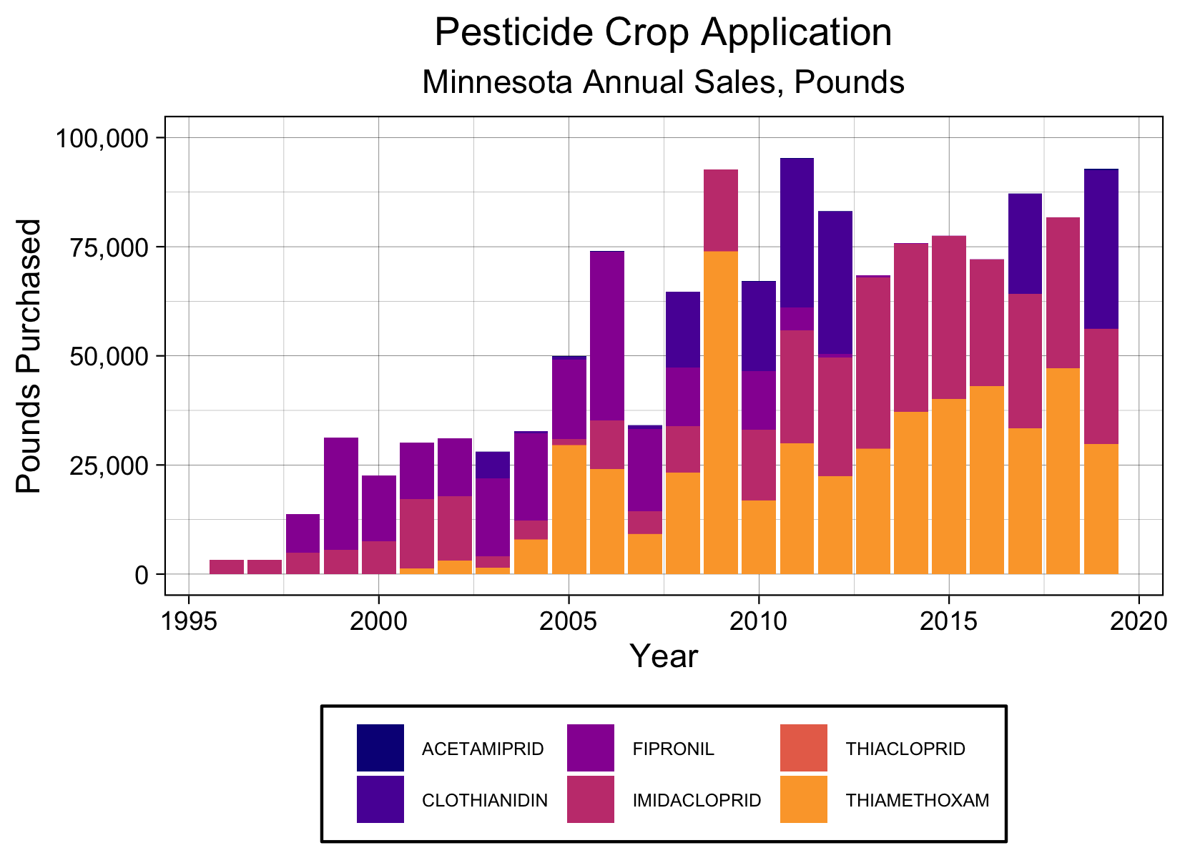
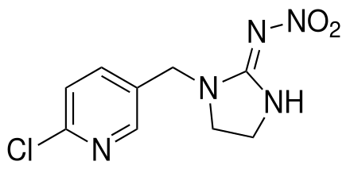
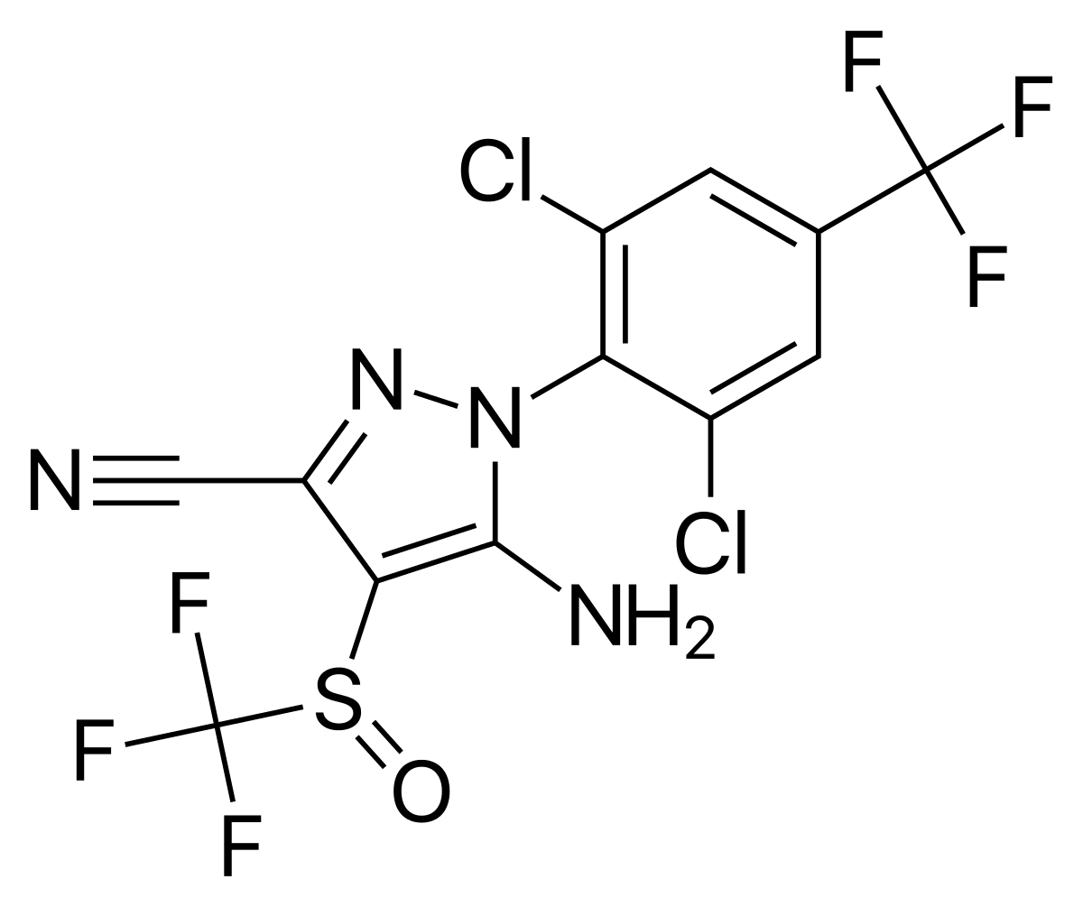
Pesticides in Minnesota’s Surface and Groundwater: Neonicotinoids, Fipronil, and Key Transformation Products. Grant Goedjen University of Minnesota Department of Civil, Environmental, and Geo-Engineering March 24th, 2022
Imidacloprid
Fipronil

Slide 2








Acknowledgments
\
Predecessor:
Matthew Berens
Partner Agencies:
Undergrads:
Sylvia Doerr
Caroline Harrington
Sydney Olson
Capital Region
Watershed District

Slide 3
Background
Study Design
Results
Implications
Questions
1
2
3
4
5

Slide 4
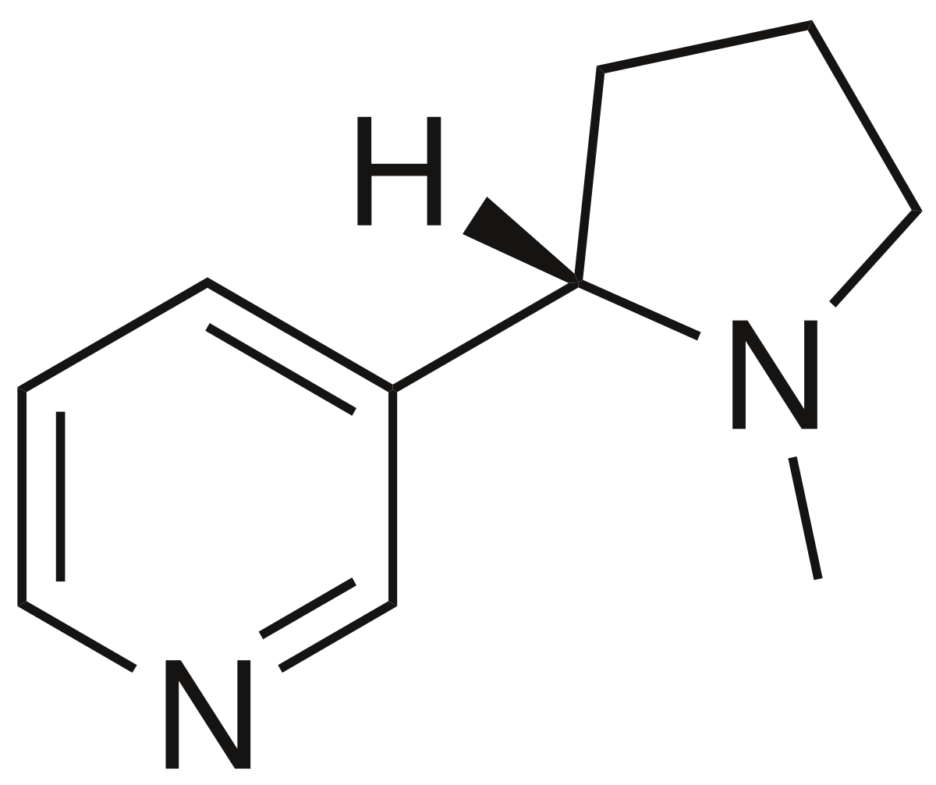
Target Compounds
Neonicotioids:
Imidacloprid synthesized in 1991.
Selective systemic insecticide.
Focuses on central nervous system.
Targets nicotinic acetylcholine receptor.
Fiproles:
First synthesized in 1996.
Broad-spectrum insecticide.
Focuses on central nervous system.
Targets GABAA-gated Cl⁻ channels.
Nicotine
Fipronil

Slide 5
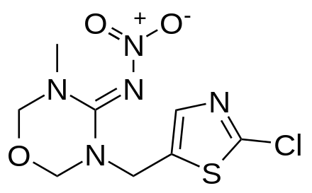
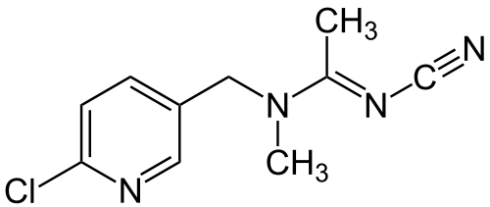
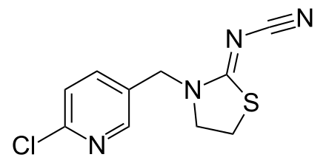
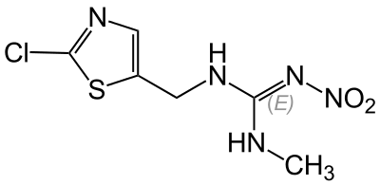
The 5 “Classical” Neonicotinoids
Fipronil
Imidacloprid
Imidacloprid Olefin
Imidacloprid Urea
Desnitro-Imidacloprid
Acetamiprid
Acetamiprid-N-Desmethyl
Thiamethoxam
Fipronil Fipronil Desulfinyl
Fipronil Sulfide
Fipronil Sulfone
Thiacloprid Thiacloprid Amide
Clothianidin

Slide 6
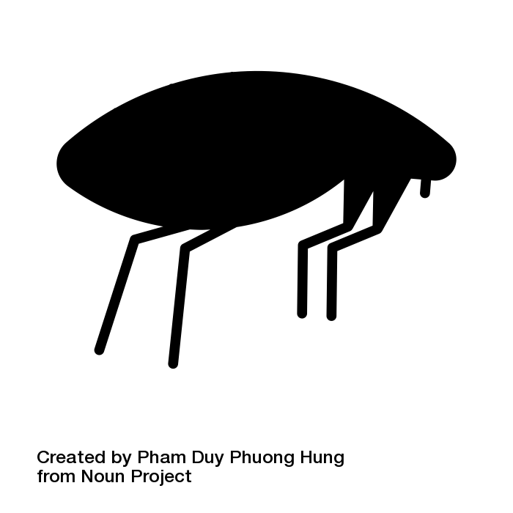

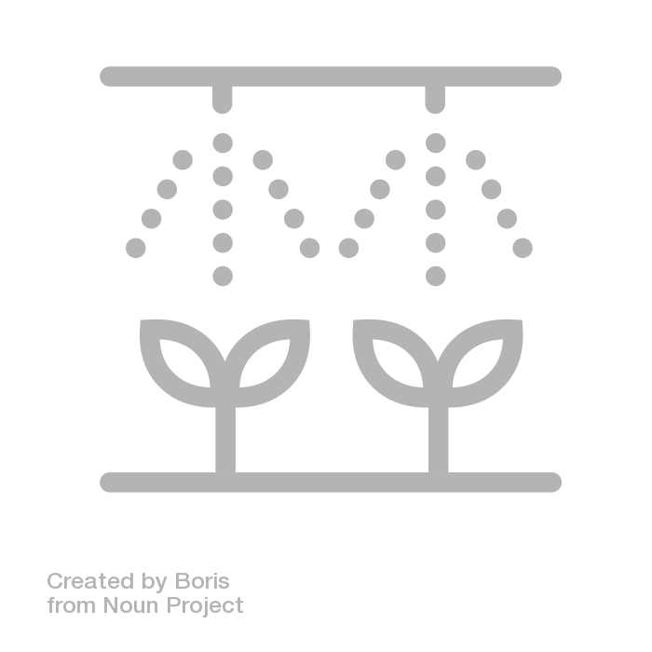

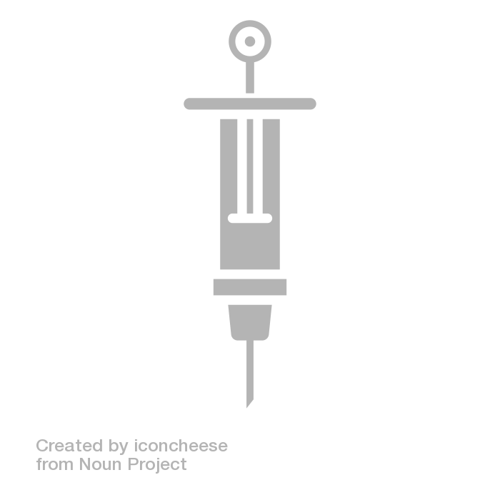

Neonicotinoids have high annual sales for crop applications.
Seed Coatings
Flea & Tick
Treatments
Spray Applications
Bedbug Treatments
Direct Injections
Termite Prevention

Slide 7
Environmental Fate
Systemic uptake into plants.
Persistent in aquatic systems.
Moderate sorption to sediment.
High solubility in water.
Negatively-impacts pollinators and non-target organisms.
Metabolized in mammals, aquatic life, and humans.
Observed contaminating food supply.
Unknown harm / risk.
Identified in surface and groundwater.

Slide 8
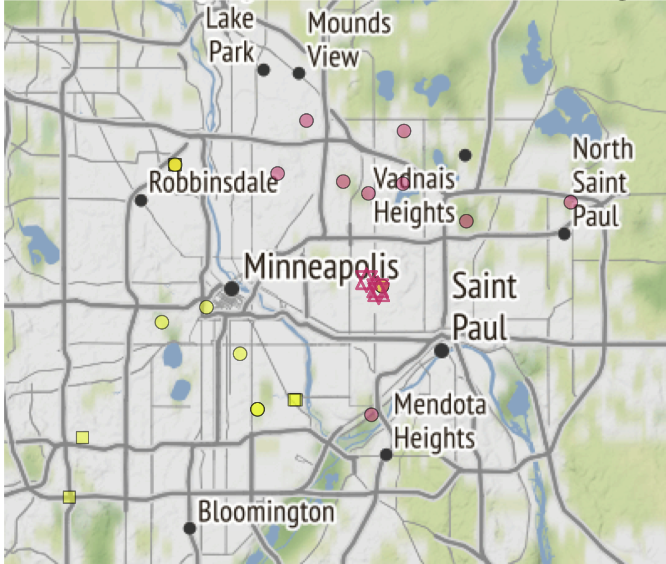
Background
Study Design
Results
Implications
Questions
1
2
3
4
5

Slide 9
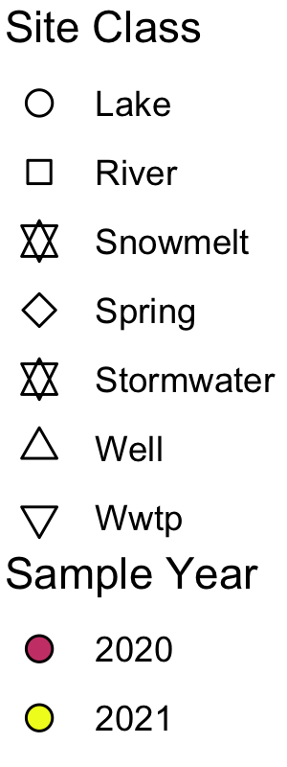
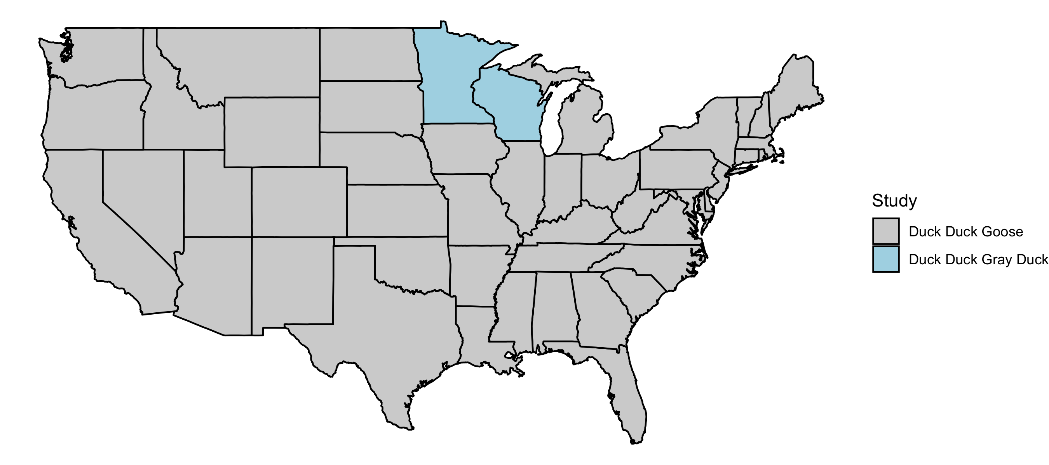
Study Area
Site Type | Sites | Samples
Lake | 22 | 198
River | 19 | 105
Well | 37 | 41
Spring | 10 | 11
Runoff | 5 | 50
Wastewater | 6 | 43
Drinking Water | 1 | 97
Notes:
Spend more time to get people acclimated to map
Highlight important areas
Point out Minnesota, Wisconsin
Highlight urban centers
Mention blue counties - locations where samples were taken
Combination of agricultural sites and developed sites
Connect detailed map to larger (next slide)

Slide 10
Study Area
Sample Collection
Site Type | Sites | Samples
Lake | 22 | 198
River | 19 | 105
Well | 37 | 41
Spring | 10 | 11
Runoff | 5 | 50
Wastewater | 6 | 43
Drinking Water | 1 | 97
Class | Sites | Samples
Lake | 22 | 198
River | 19 | 105
Well | 37 | 41
Spring | 10 | 11
Runoff | 5 | 50
Notes:
Spend more time to get people acclimated to map
Highlight important areas
Point out Minnesota, Wisconsin
Highlight urban centers
Mention blue counties - locations where samples were taken
Combination of agricultural sites and developed sites
Connect detailed map to larger (next slide)

Slide 11
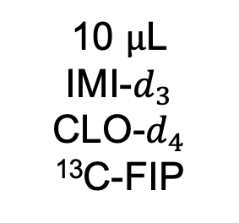
Solid Phase
Extraction
DCM
ACE
MQ
5 mL
5 mL
10 mL
10
9
8
7
6
Cold
Storage
4℃
10 $μ$L
IMI-$d_{3}$
CLO-$d_{4}$
¹³C-FIP
Glass
Fiber
Filter

Slide 12
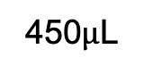
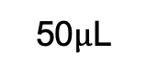
Reconstitution
¹³C-Caffeine ISTD
QQQ LC/MS-MS
10
9
8
DCM
ACE
7
ESI
+ / -
6
5 mL
5 mL
N₂
ACN
MQ
50$μ$L
450$μ$L

Slide 13
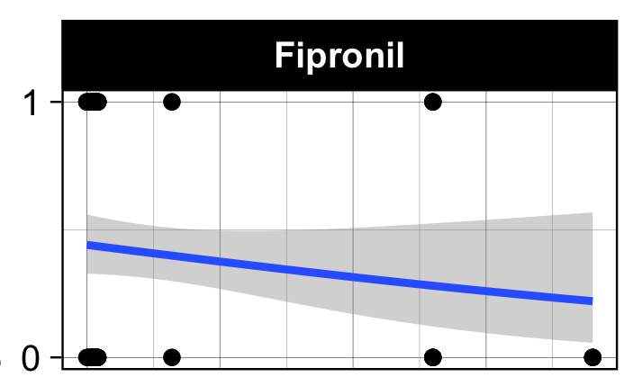
Background
Study Design
Results
Implications
Questions
1
2
3
4
6

Slide 14
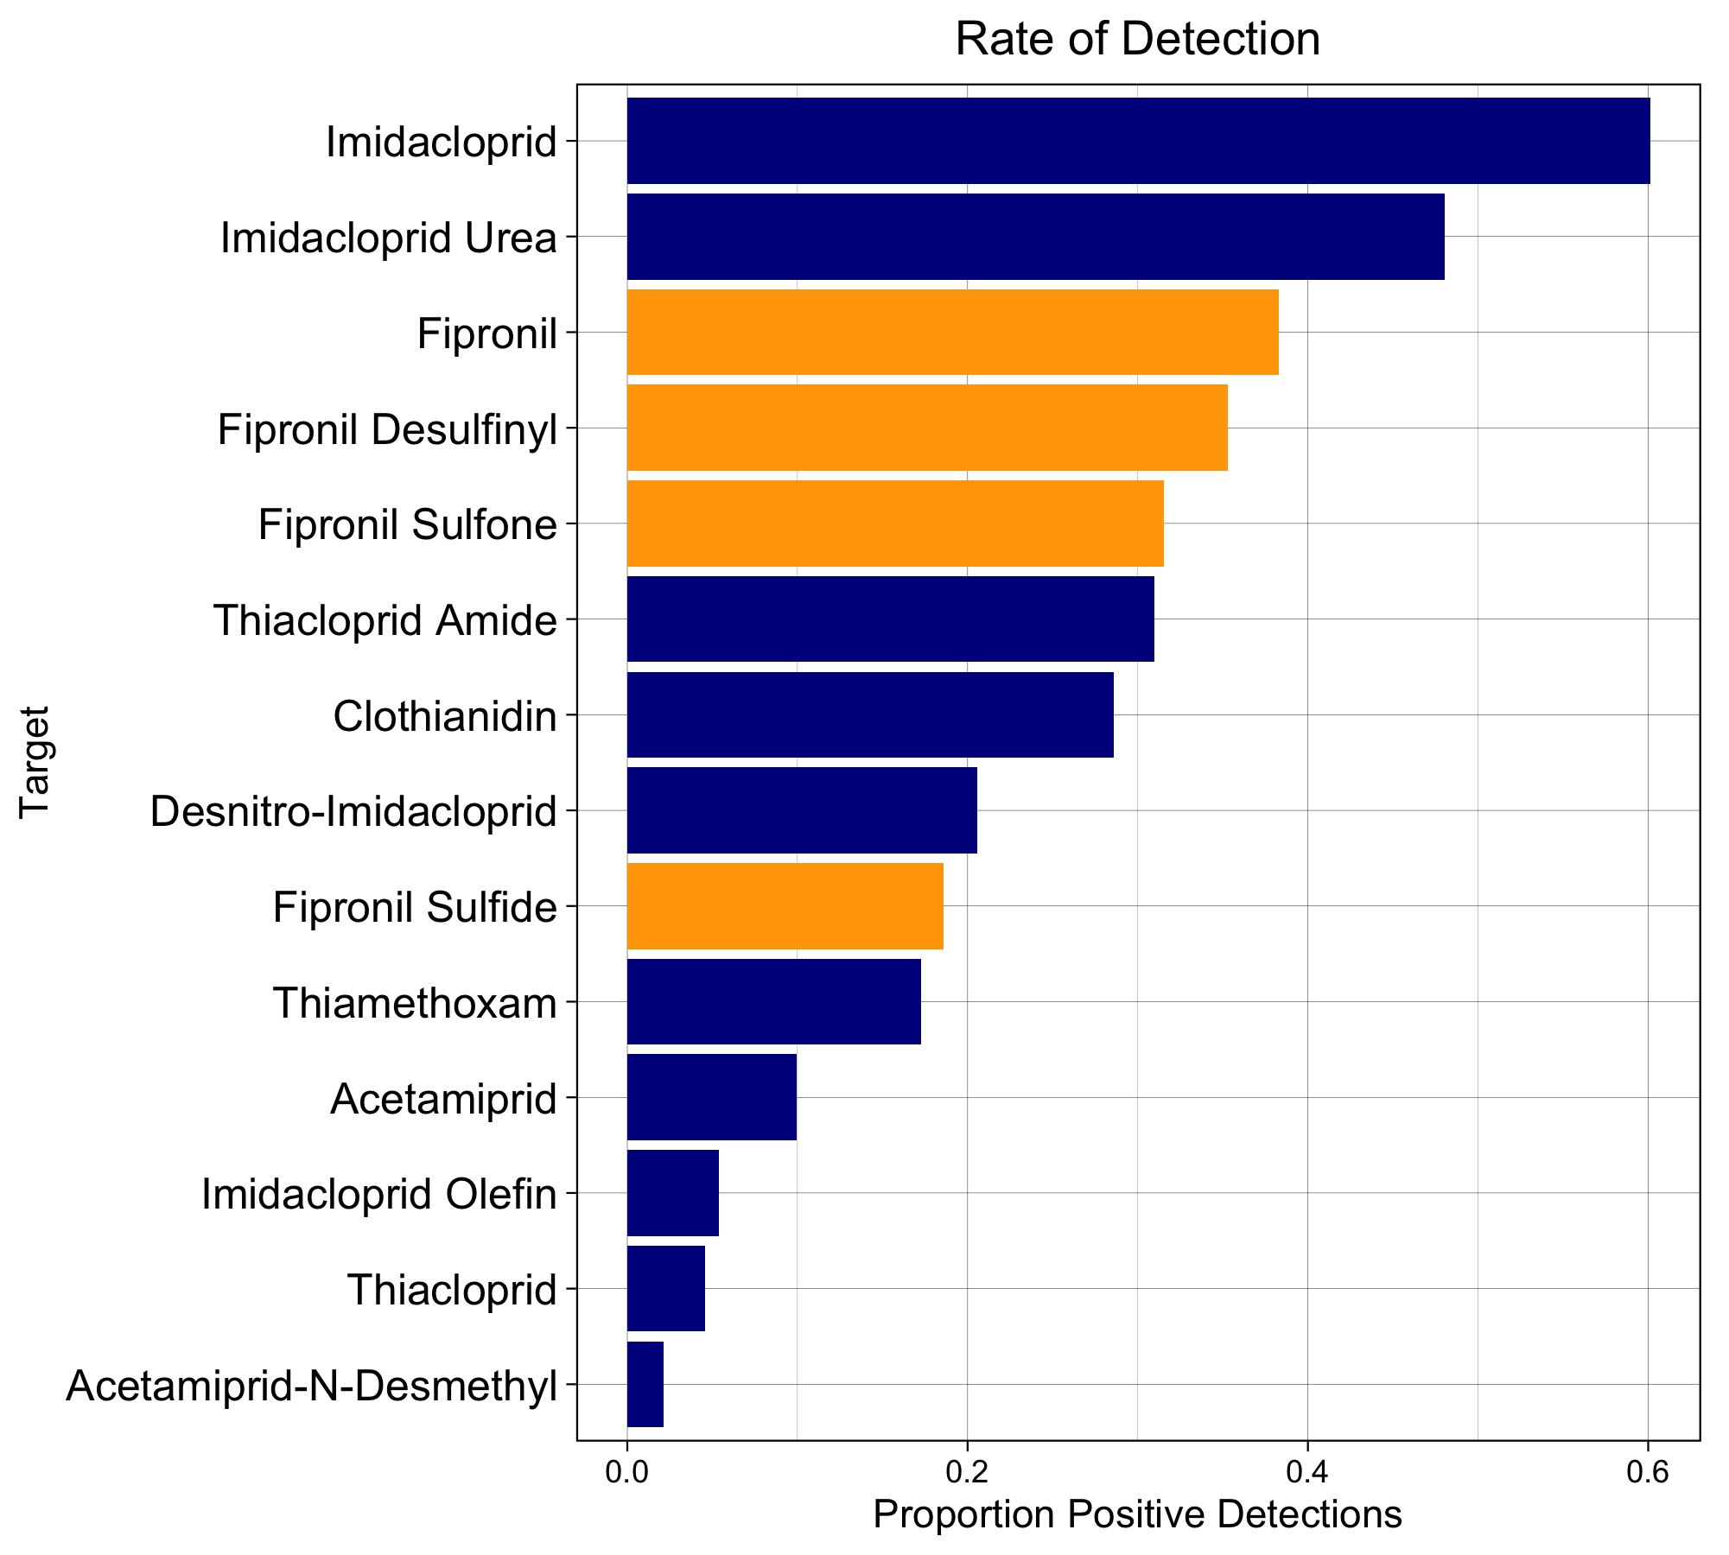
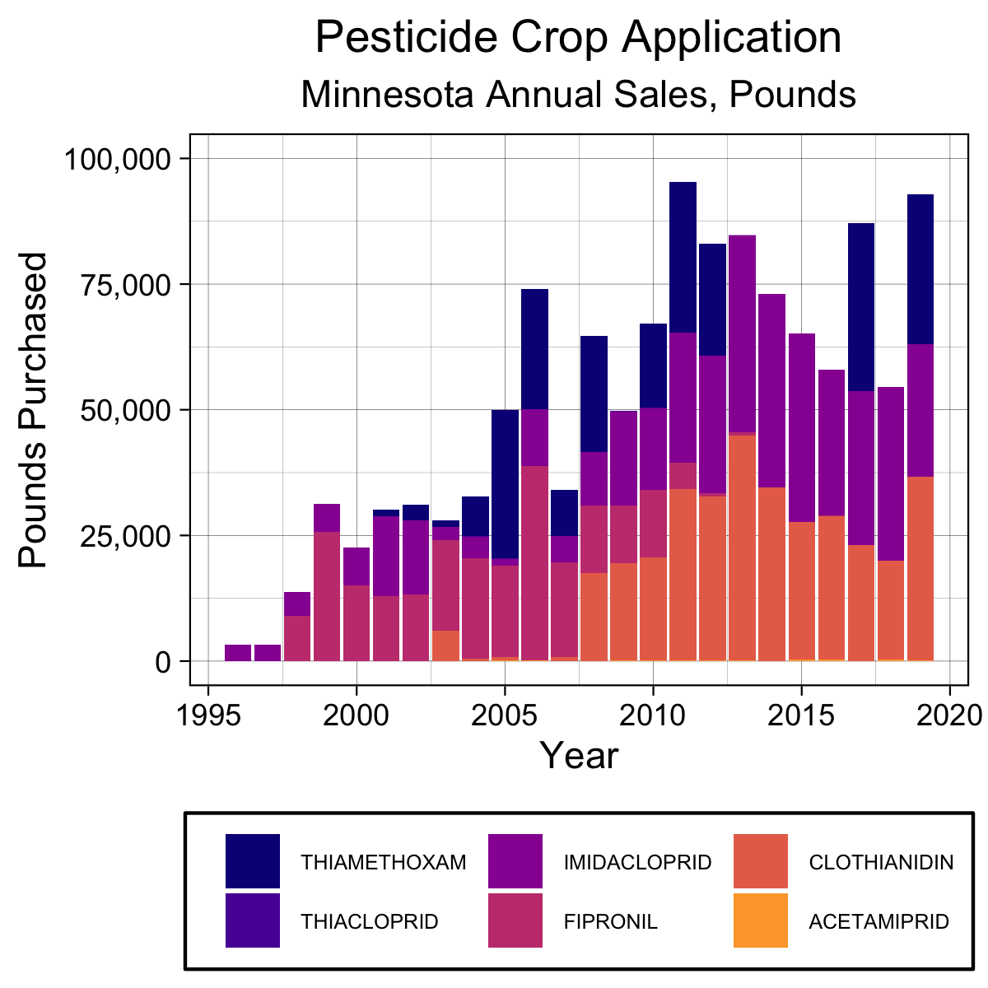
Purchase rate is a strong indicator of pesticide detection.
Imidacloprid highest-detected neonicotinoid.
Fipronil highest-detected fiprole.
Purchase rates directly associated with detection freq..
All sites sampled
All matrices included
Notes:
-Where are neonics / fipronils
-How do metabolites fit into?
-Why are these in this order?
Don’t mix percent / proportions

Slide 15
Purchase rate is a strong indicator of pesticide detection.
Notes:
-Where are neonics / fipronils
-How do metabolites fit into?
-Why are these in this order?
Don’t mix percent / proportions

Slide 16
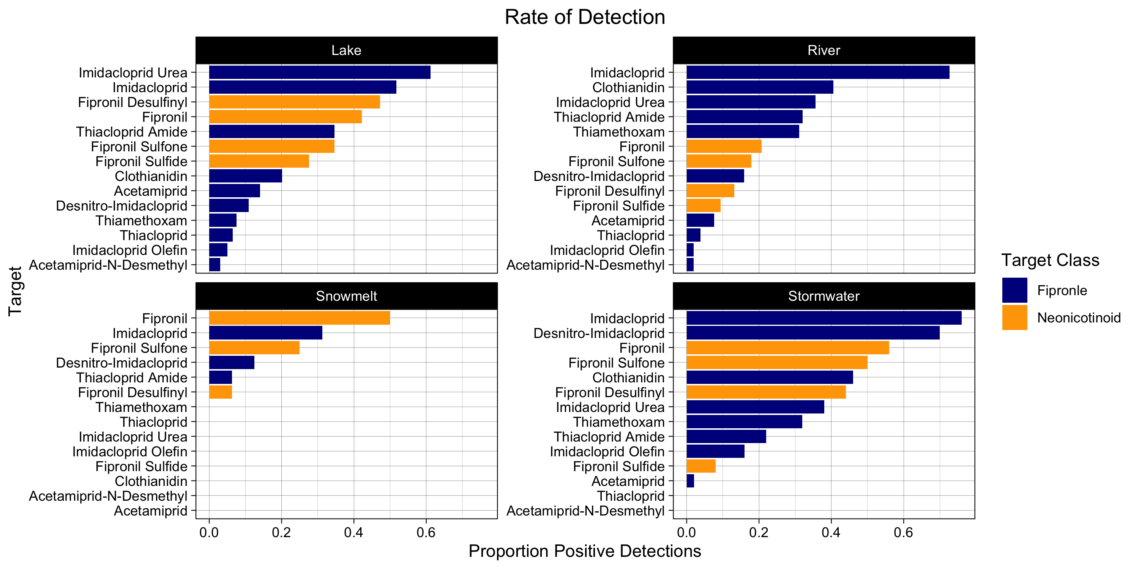
Purchase rate is a strong indicator of pesticide detection.
Proportions Positive Detections
Notes:
-Where are neonics / fipronils
-How do metabolites fit into?
-Why are these in this order?
Don’t mix percent / proportions

Slide 17
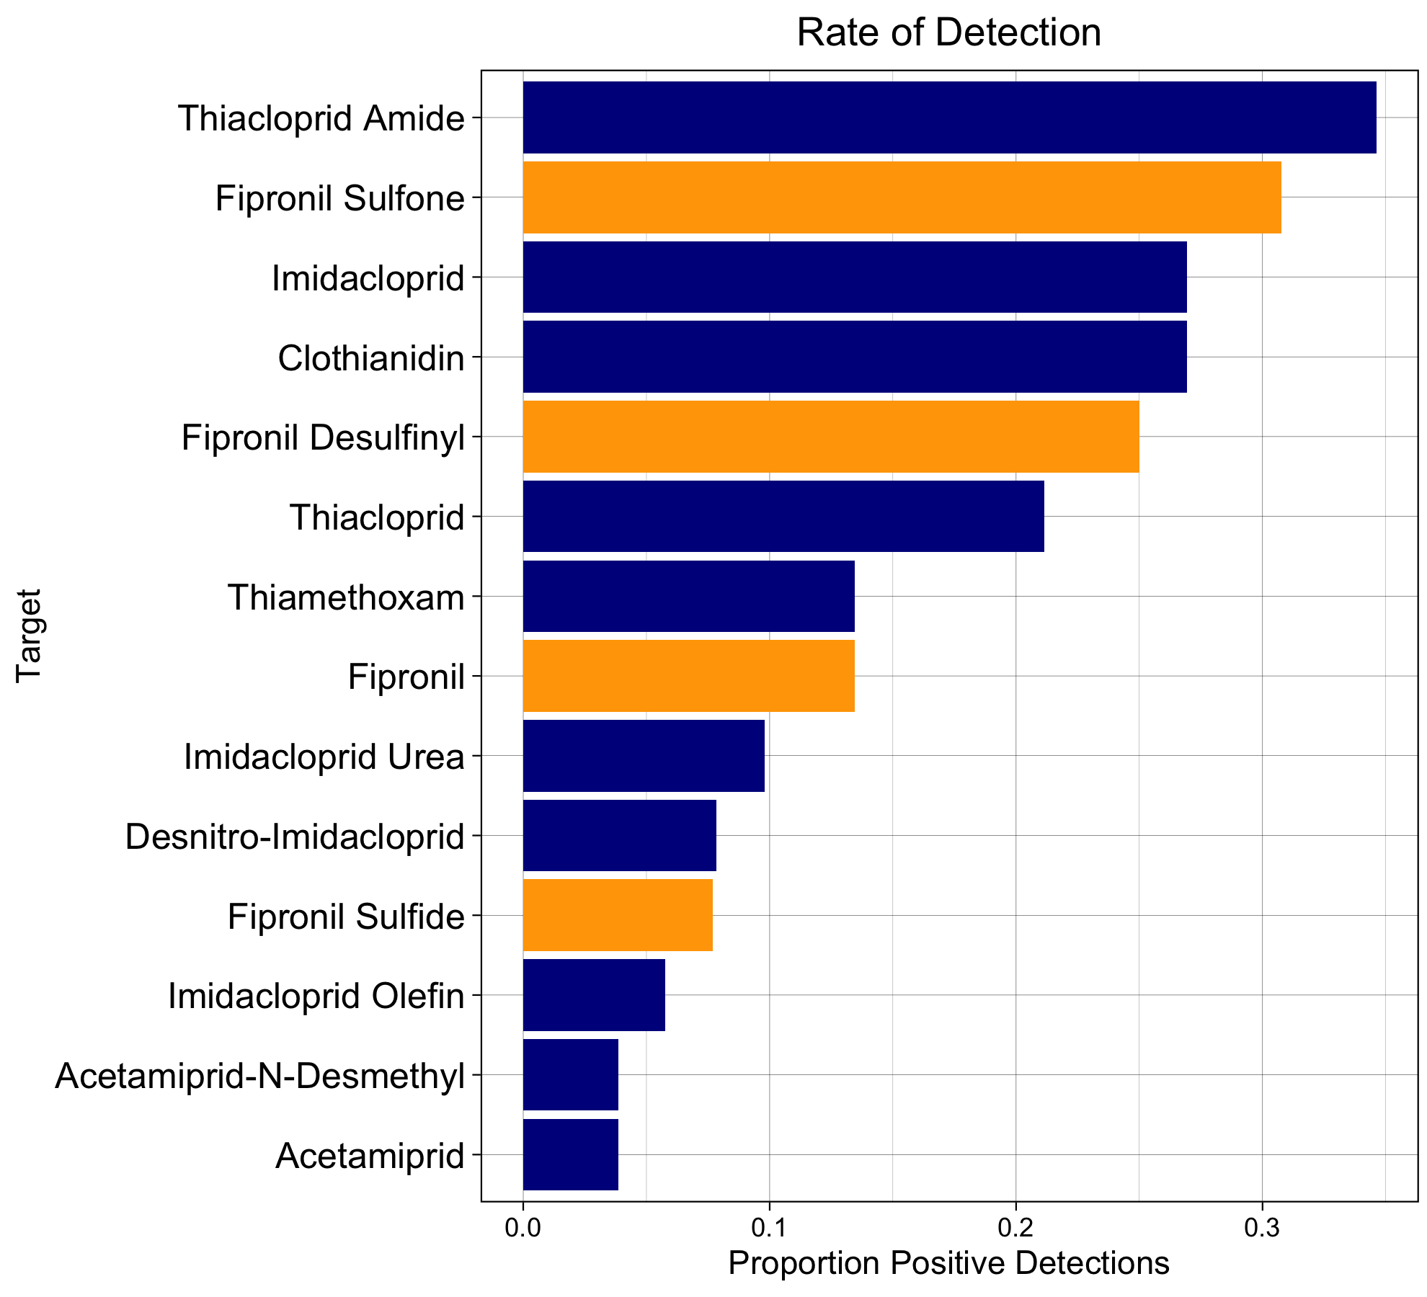
Purchase rate is a strong indicator of pesticide detection.

Slide 18
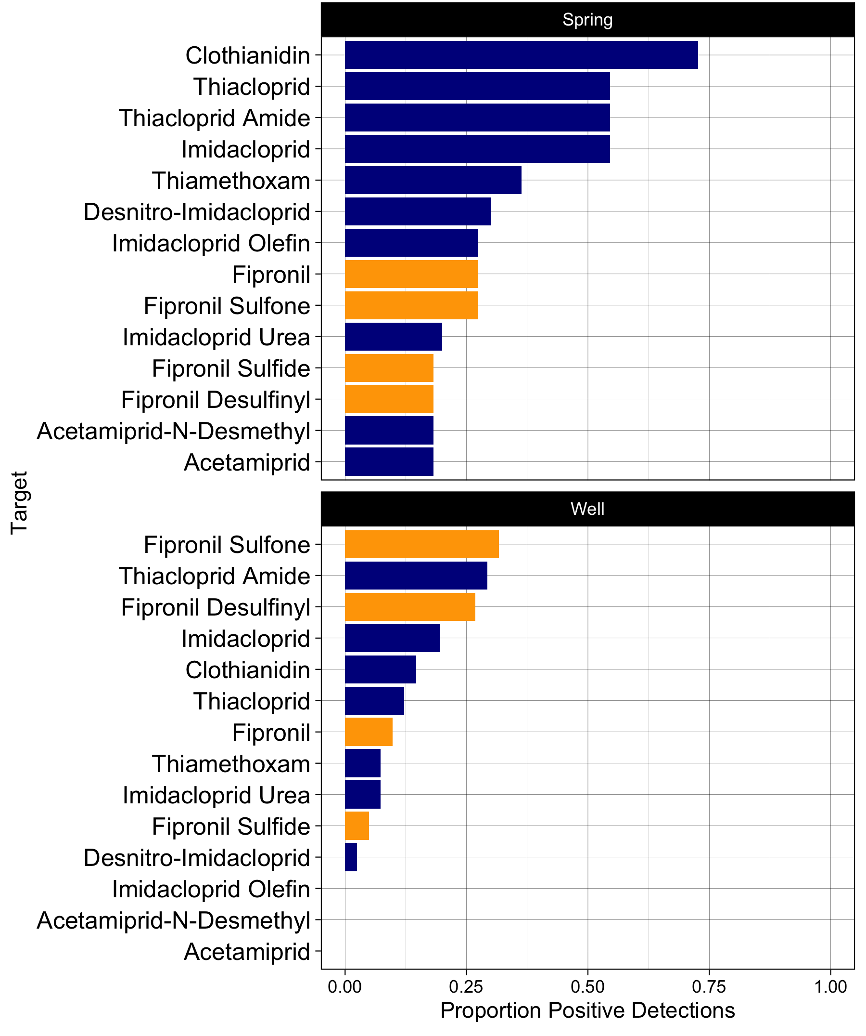
Purchase rate is a strong indicator of pesticide detection.

Slide 19
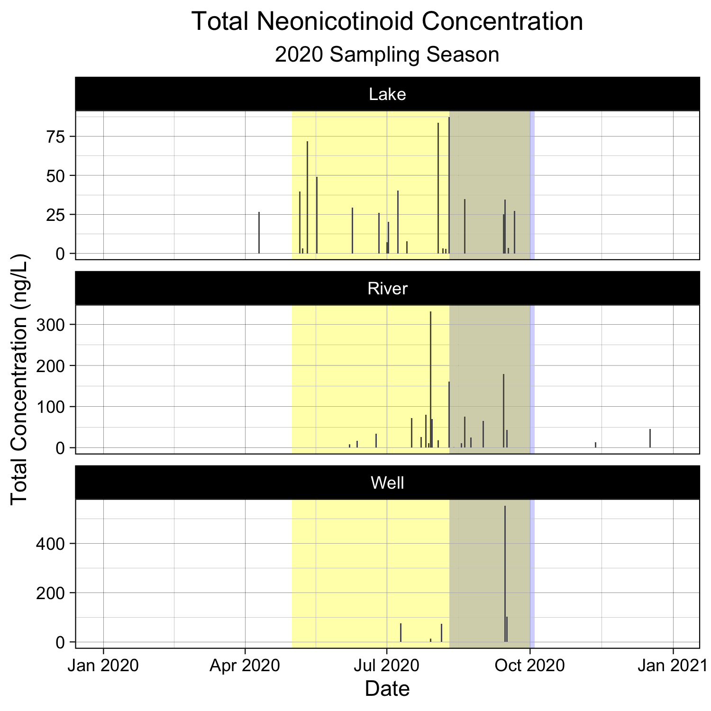
Total neonic concentrations highest during rainy and growing seasons.
Lakes
Concentrations peak during peak growing season.
Largest spring detections during rainy season.
Rivers
Wells / Springs
Notes:
Each graph represents multiple lakes / streams / rivers.

Slide 20
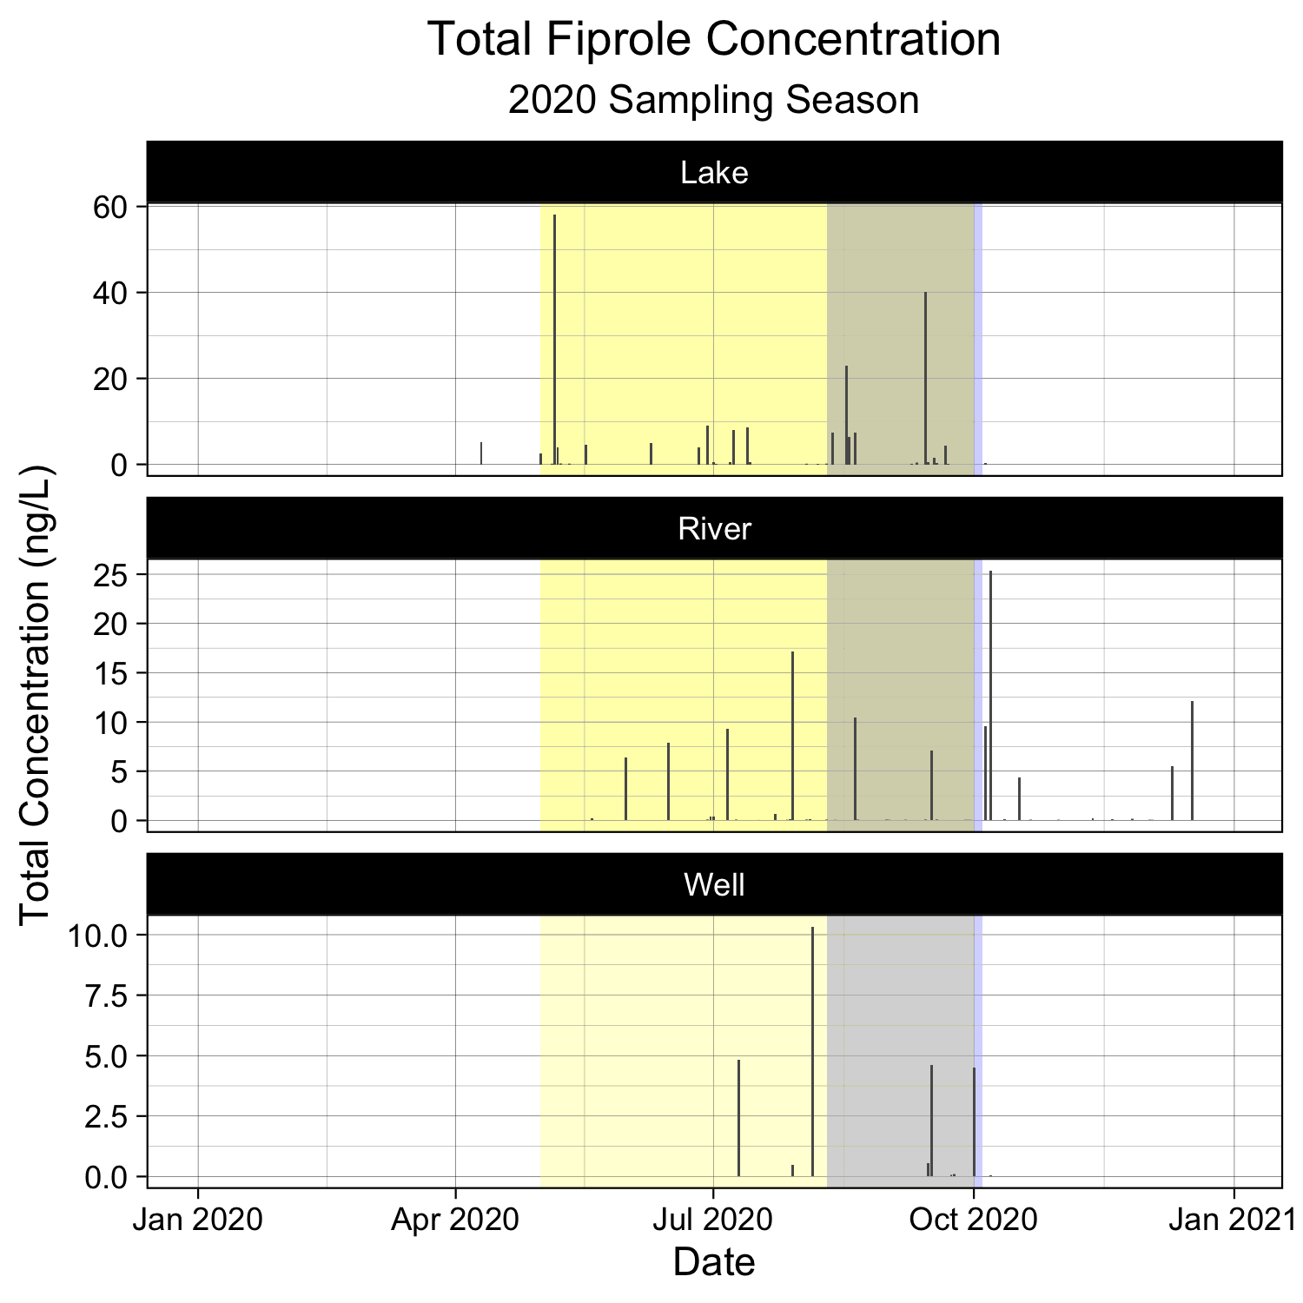
Total fipronil concentrations highest during rainy and growing seasons.
Lakes
Concentrations peak during growing season.
Rate of detection highest during growing season.
Spring concentrations highest during late growing season / rainy season.
Rivers
Wells / Springs

Slide 21
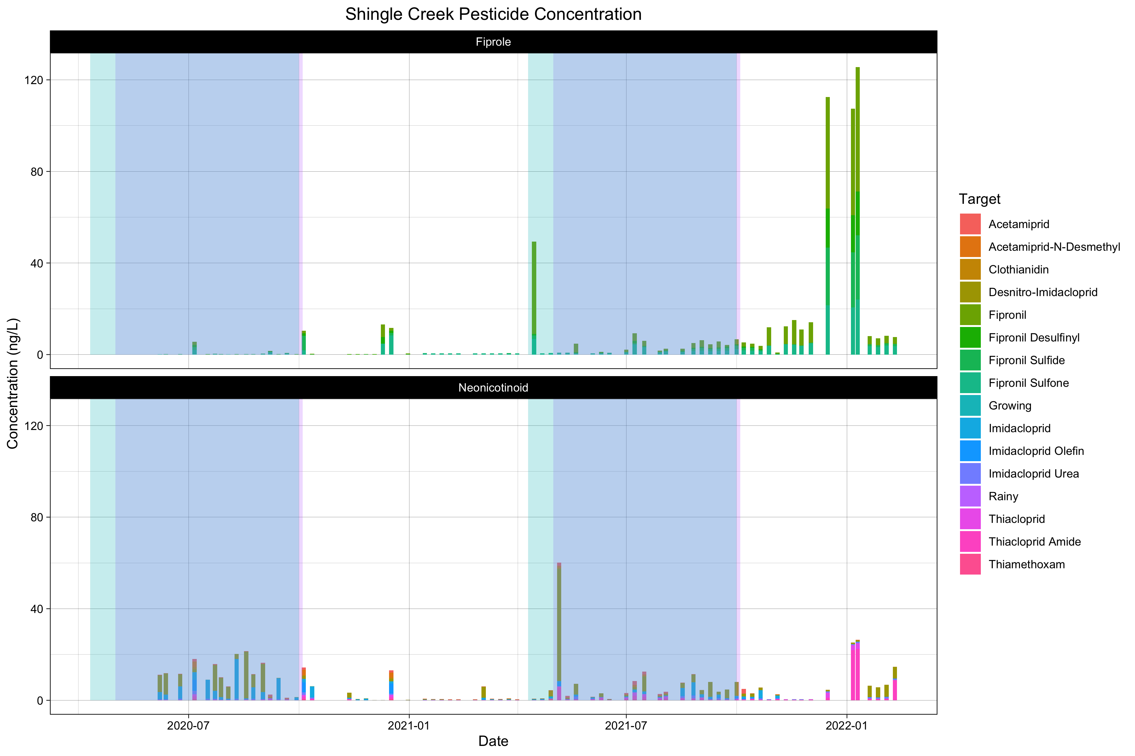
Total pesticide concentrations highest during rainy and growing seasons

Slide 22
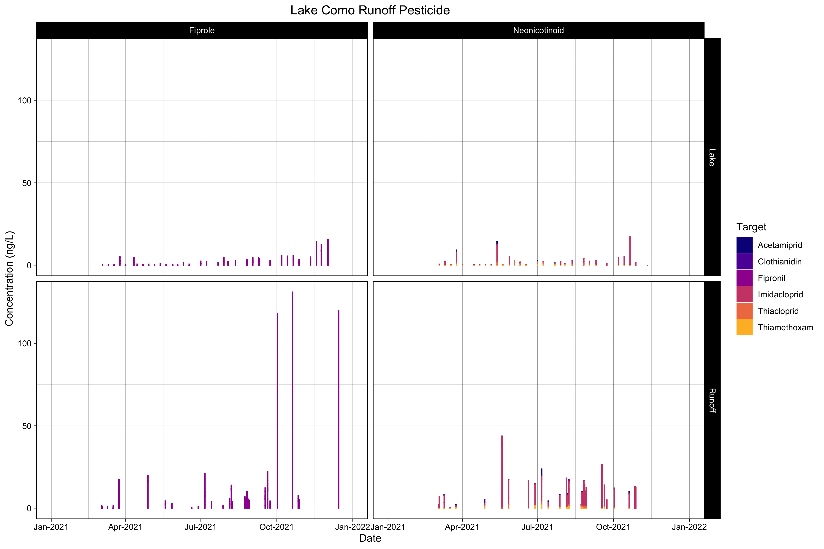

High-strength runoff may influence total pesticide concentrations.

Slide 23
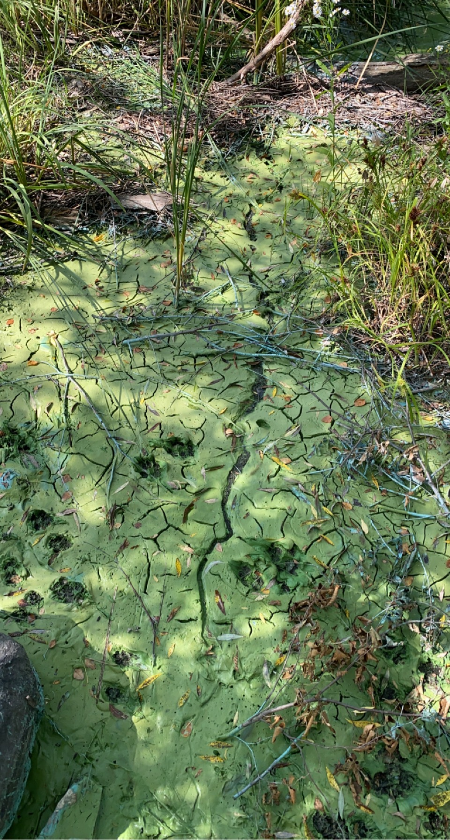

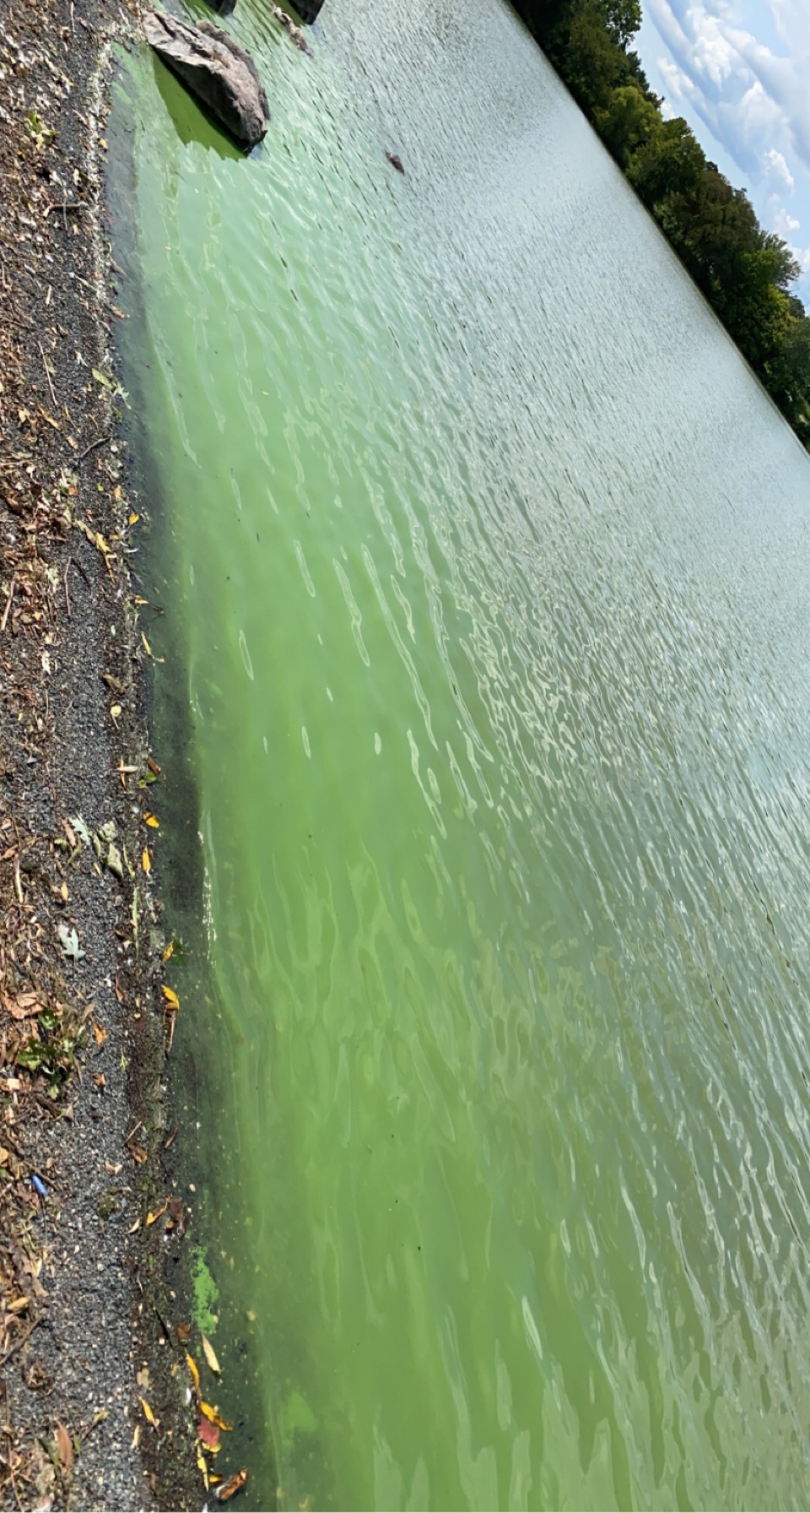
High-strength runoff may influence total pesticide concentrations.

Slide 24
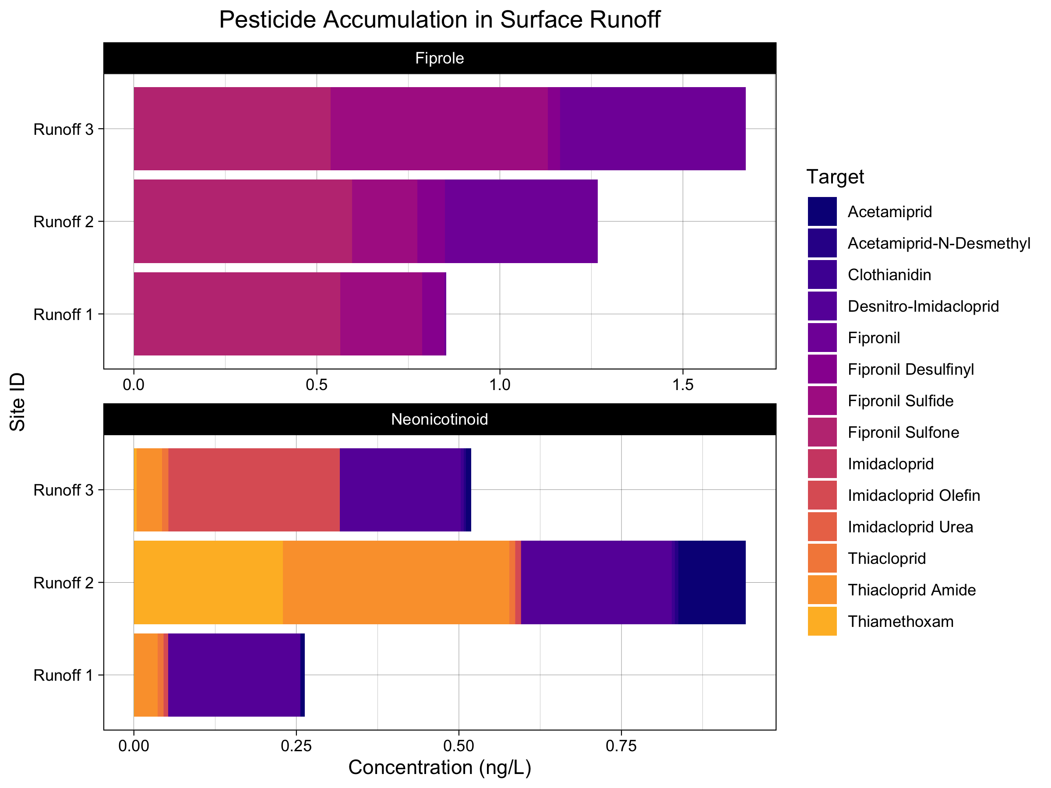
High-strength runoff may influence total pesticide concentrations

Slide 25
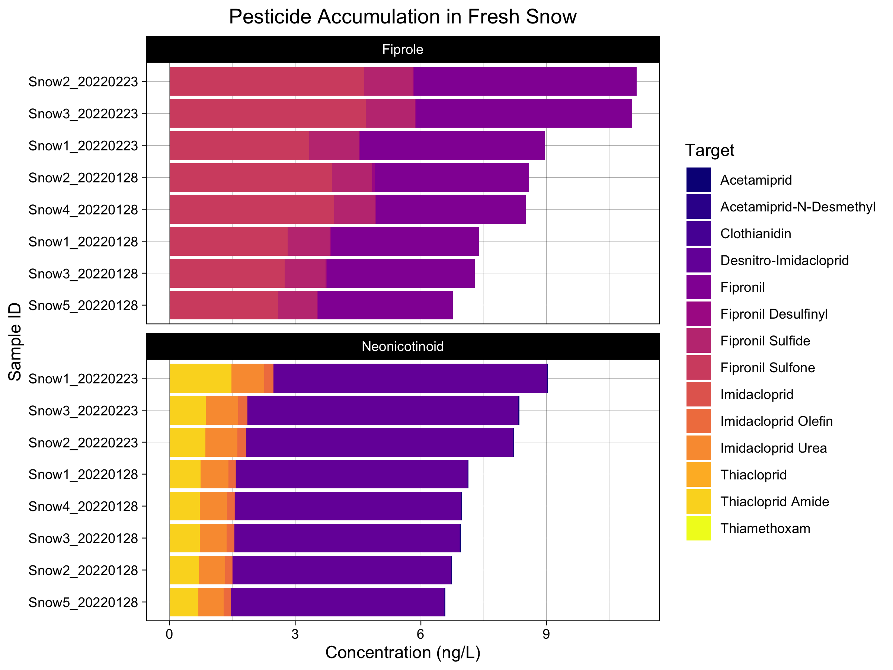
Snowfall acts as secondary transport for pesticides.
Particle

Slide 26
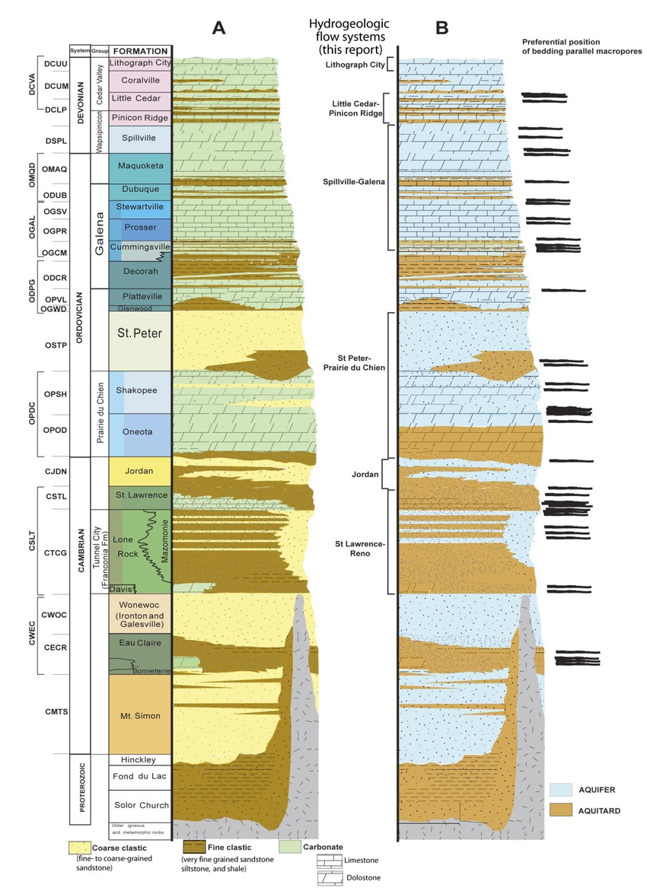
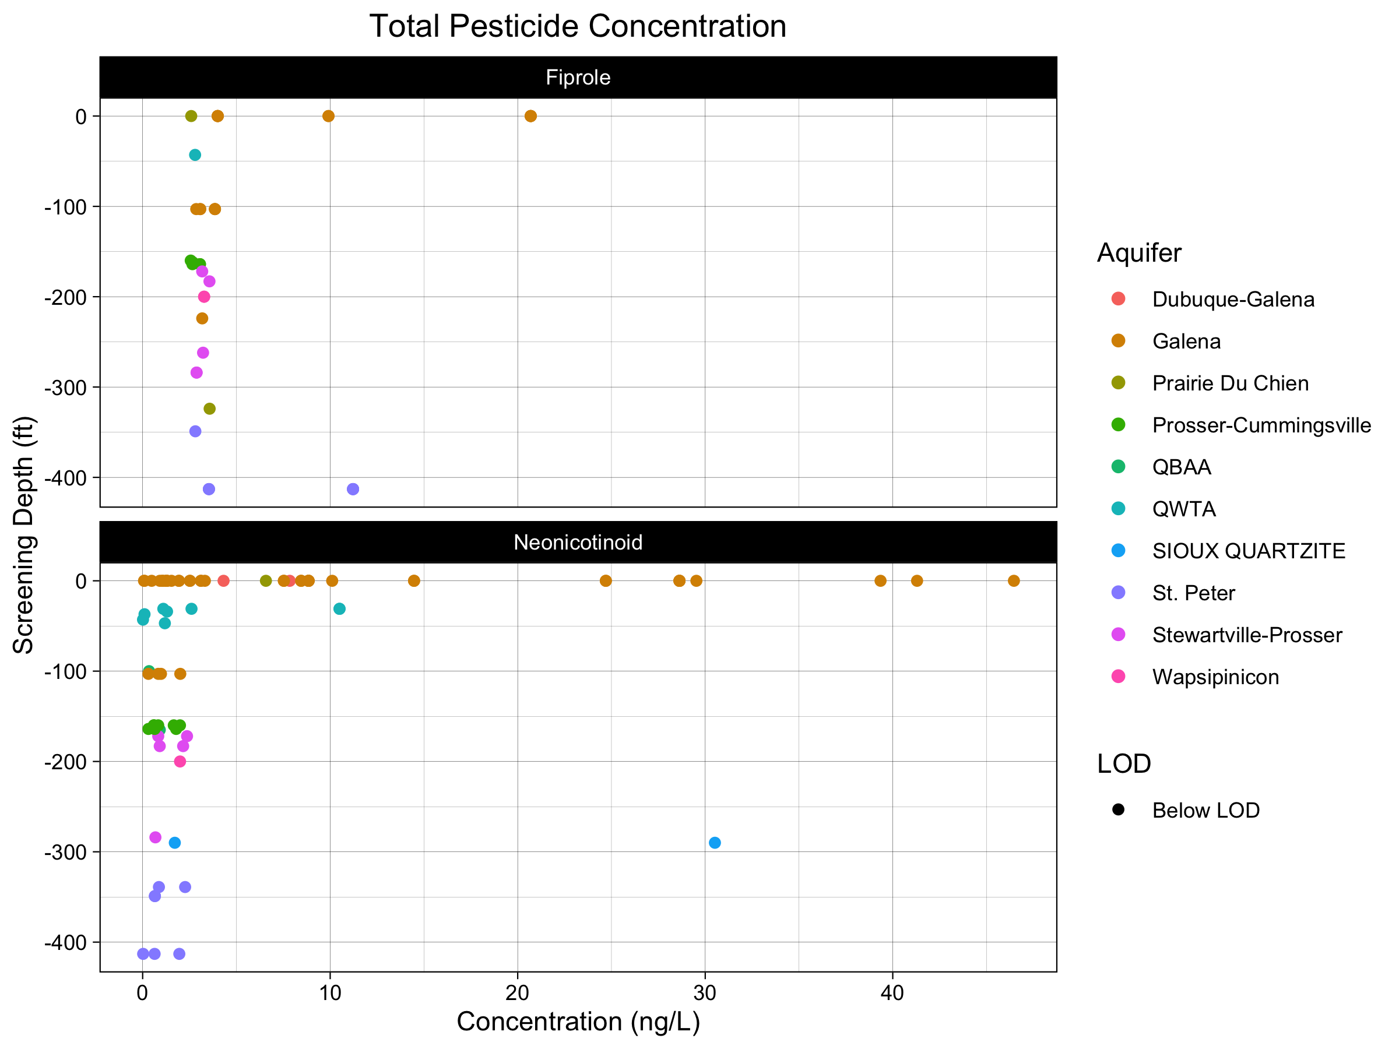
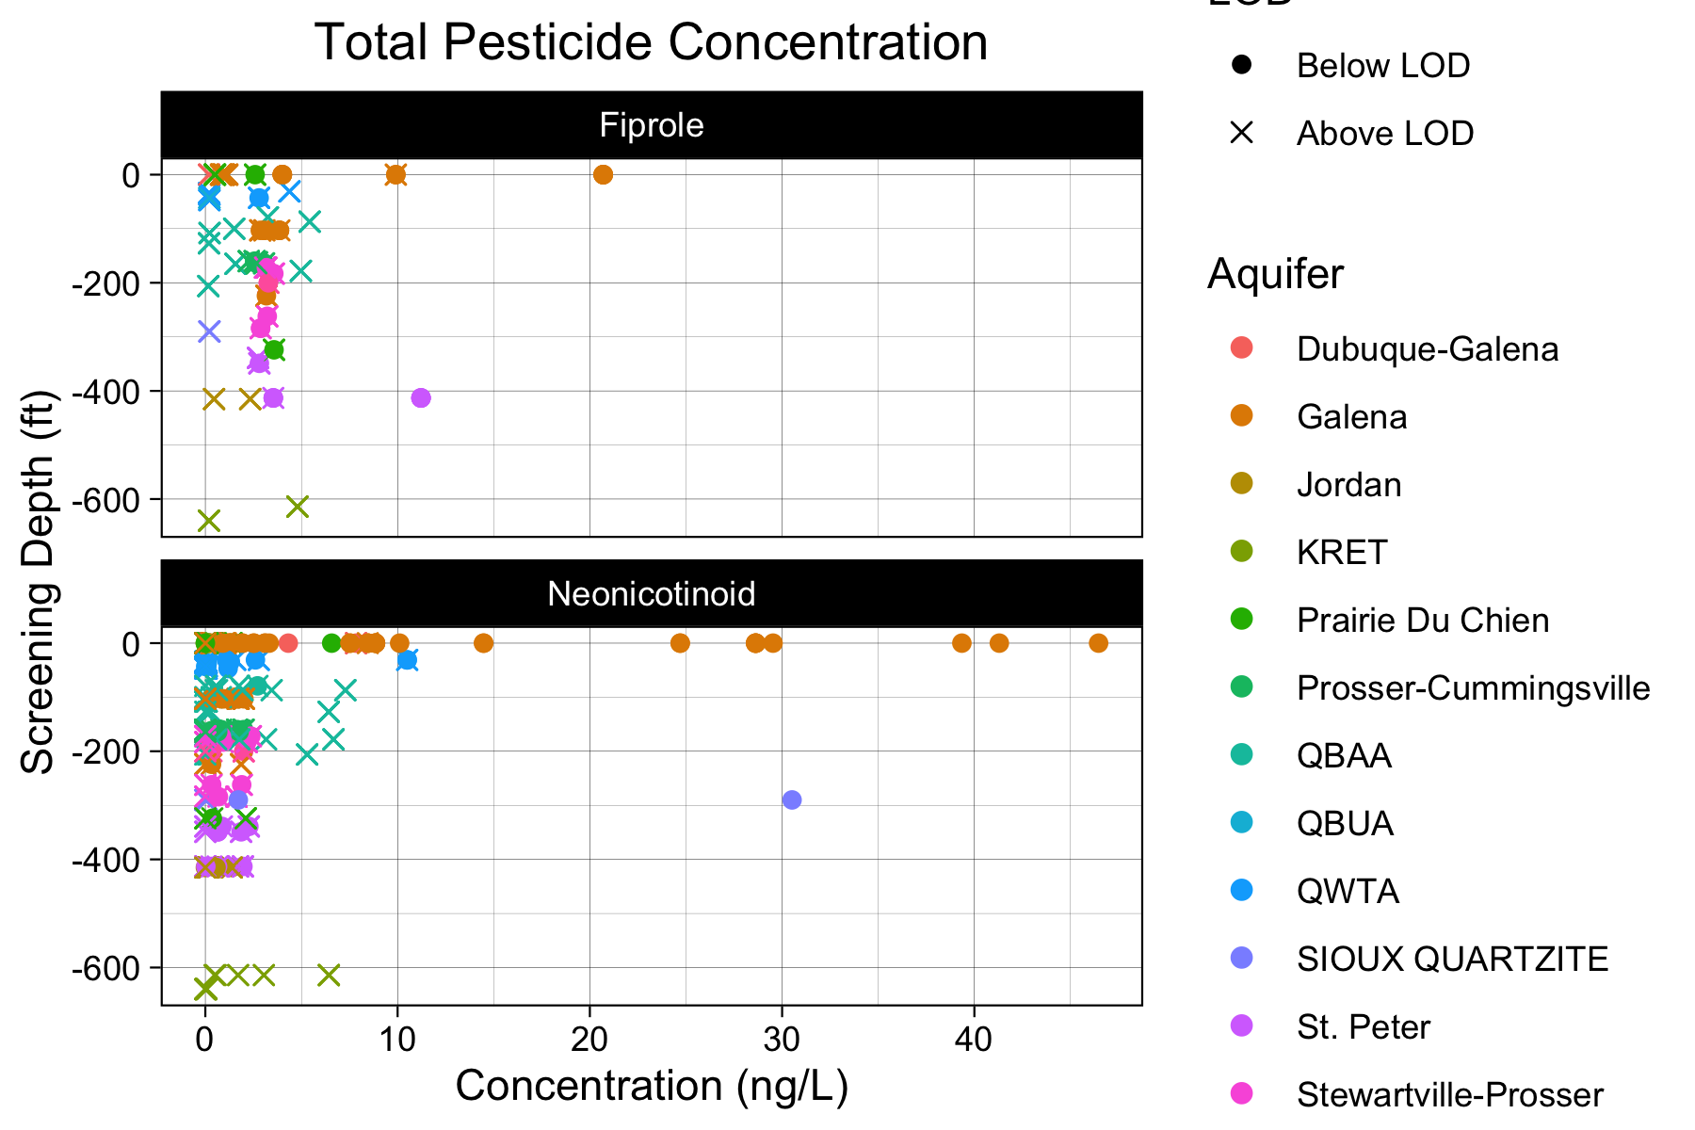
Fipronil and neonicotinoid concentrations increase exponentially with casing depth.
10.1061/41003(327)46

Slide 27
Background
Study Design
Results
Implications
Questions
1
Imidacloprid
Clothianidin
Thiacloprid
2
3
4
5

Slide 28
Key Takeaways:
Lakes and groundwater act as long-term reservoirs for longer-term degradation.
Seasonality, Application Rate increase concentration and rate of detection.
Shallow, unconfined aquifers highest risk for groundwater contamination.
Previously overlooked forms of precipitation may be key transport mechanism.
Imidacloprid
Clothianidin
Thiacloprid

Slide 29


Slide 30

Grant Goedjen
University of Minnesota
Dept. of Civil, Environmental, and Geo-Engineering
Goedj011@umn.edu
(832) 445-7265
https://WilliamArnold.org

Slide 31
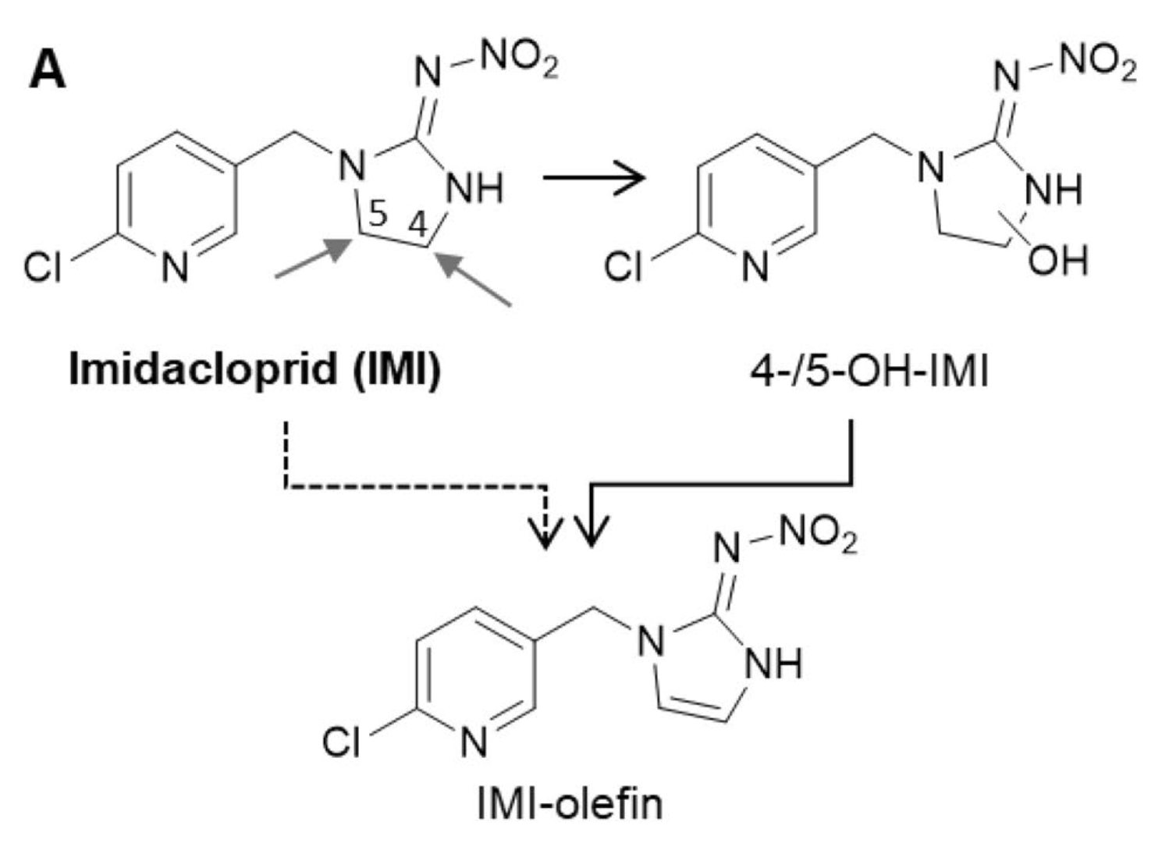
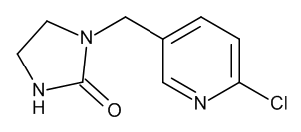

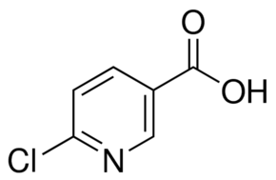
TPs: Imidacloprid
IMI-Urea
6-CNA

Slide 32
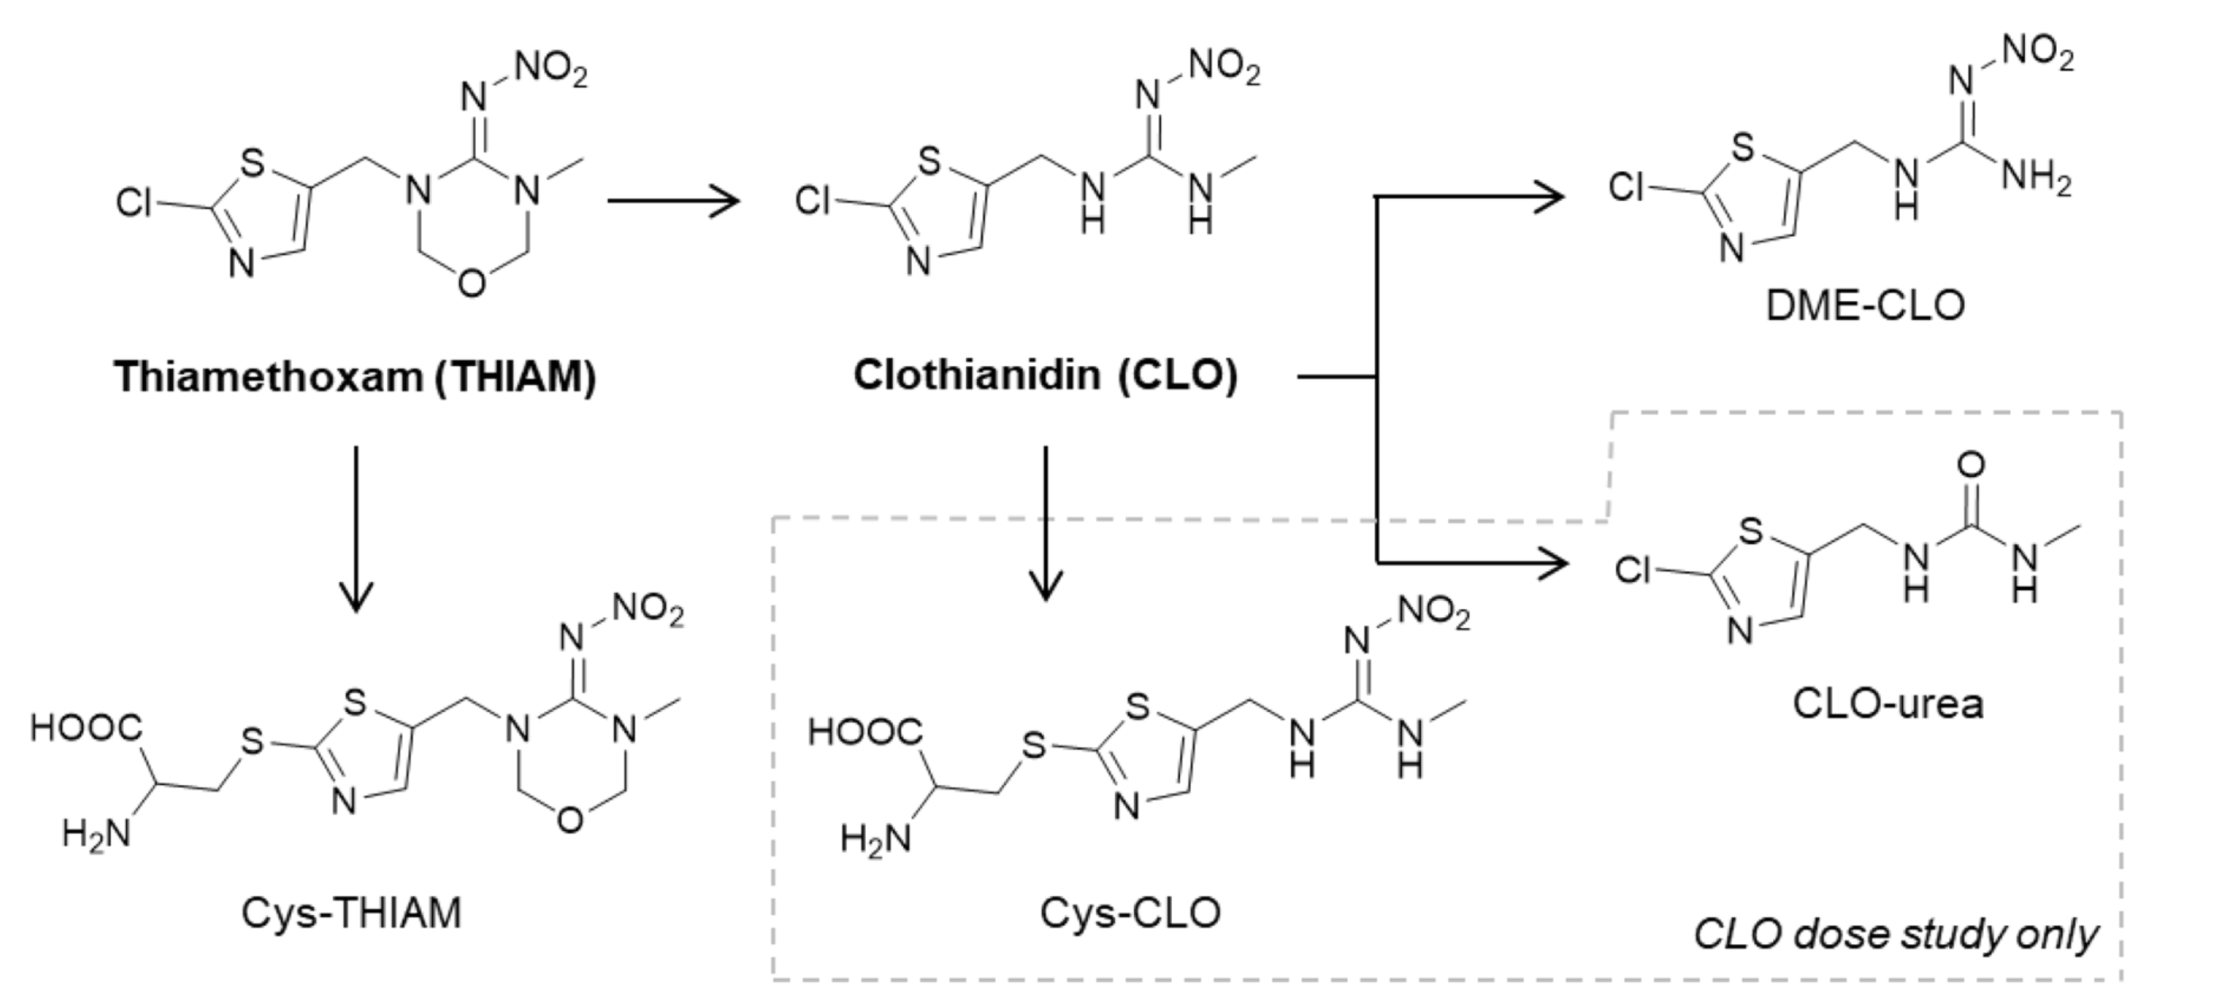
TPs: Thiamethoxam /Clothianidin
Mammalian Metabolites
Notes:
Human metabolites never looked for In wastewater treatment plants – only recently identified in humans.

Slide 33
Effect of Land Use: Logistic Regression
Target Detected
Target
Regression Uncertainty
Logistic Regression
Target Not Detected
Proportion of Land
Individual Sample

Slide 34
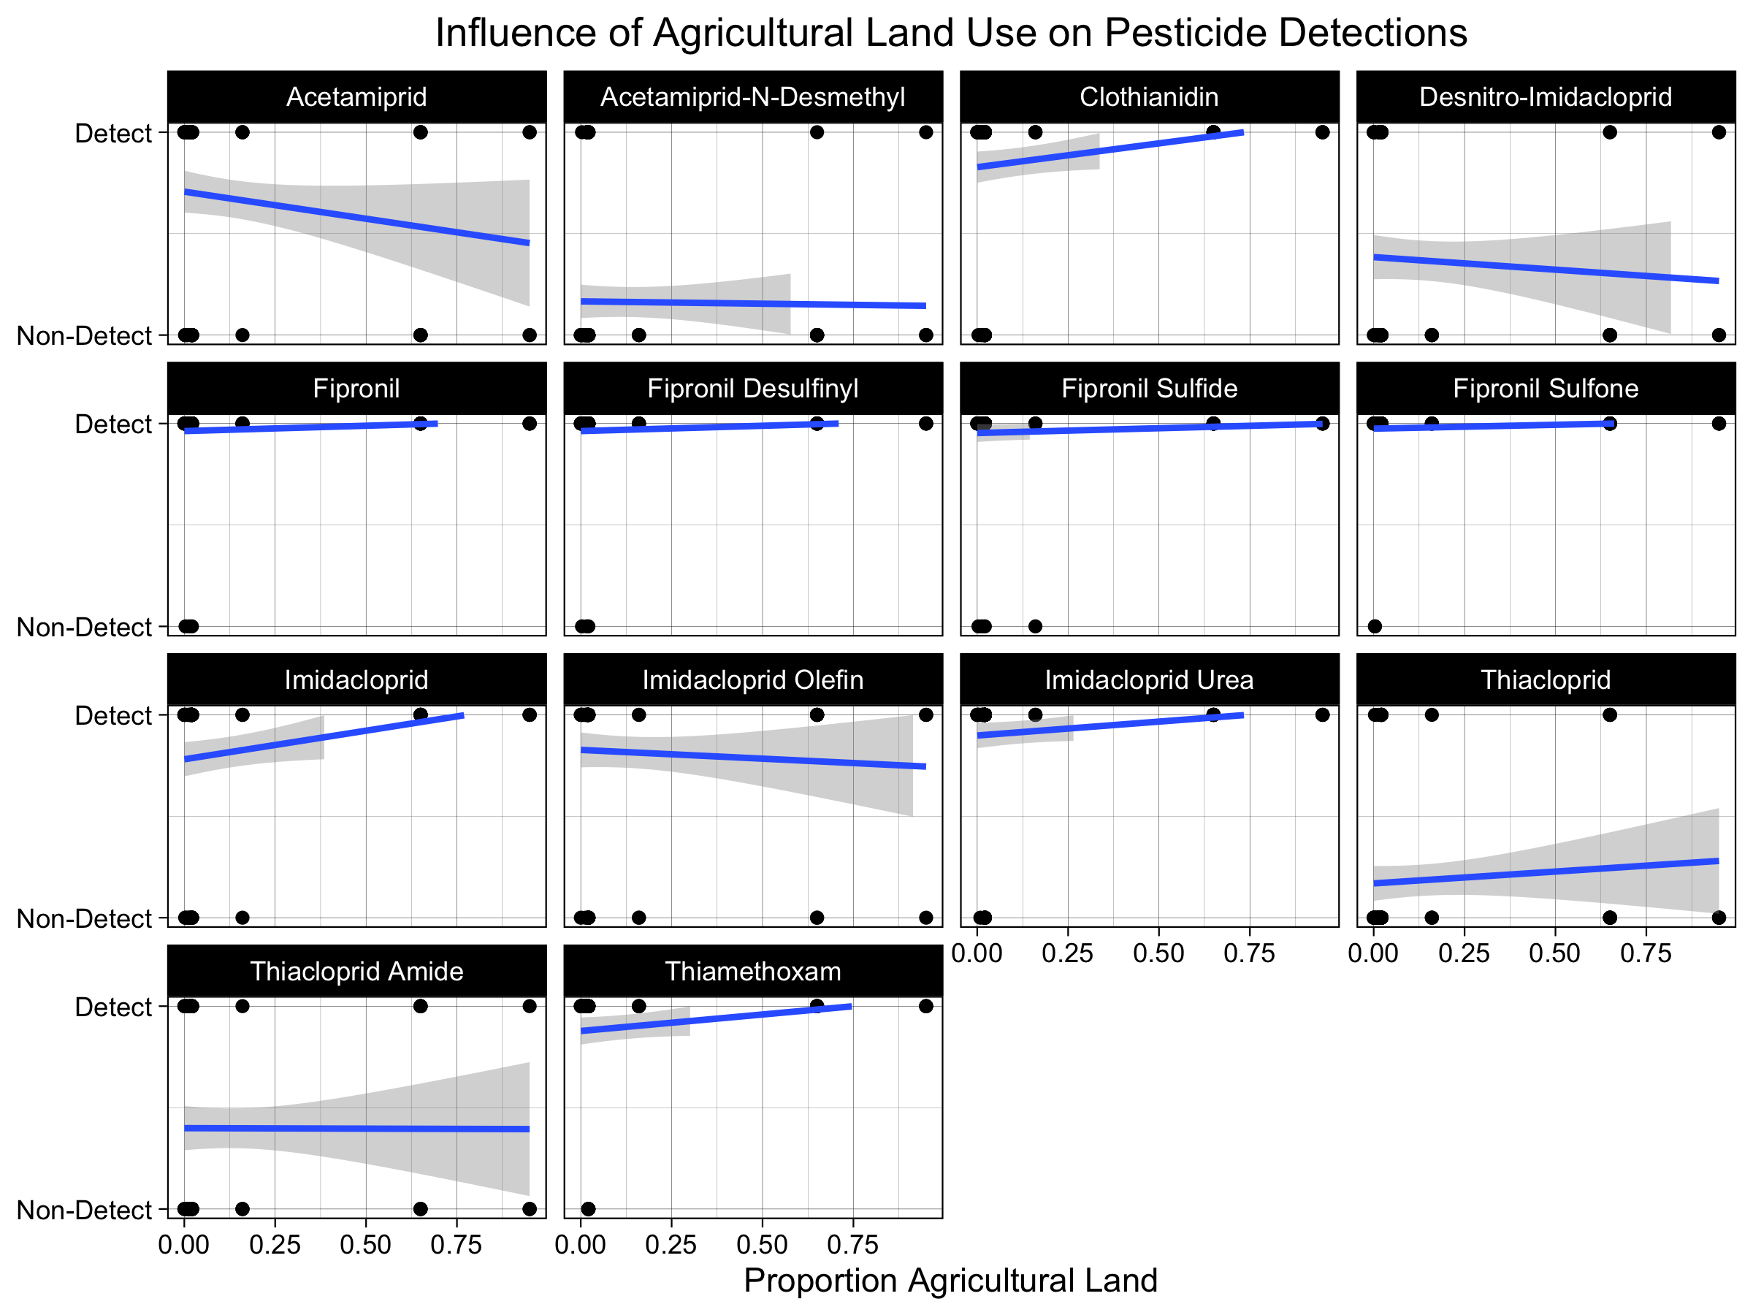
Agricultural
land use not a significant predictor of pesticide detection.
Notes:
Take longer explaining axis’ and graph
Explain logistic models
Switch agricultural and developed.
Explain multiple samples hidden within each dot.

Slide 35
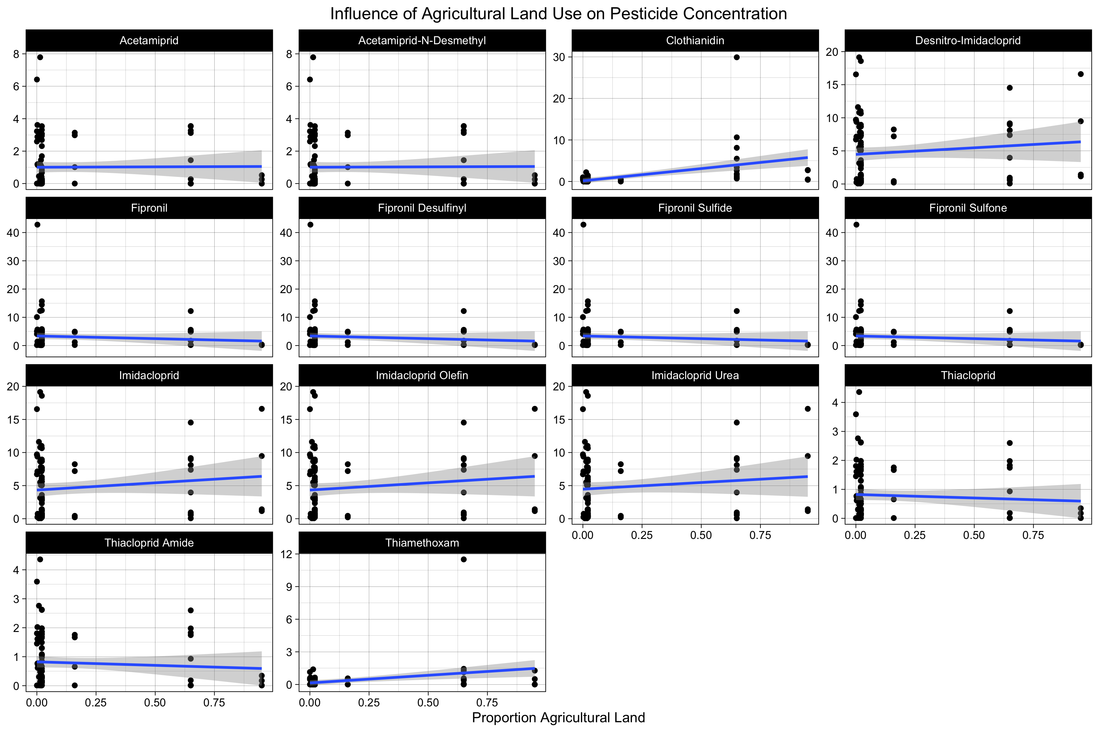
Agricultural land use is not a significant predictor of pesticide concentrations.
Notes:
Take longer explaining axis’ and graph
Explain logistic models
Switch agricultural and developed.
Explain multiple samples hidden within each dot.

Slide 36
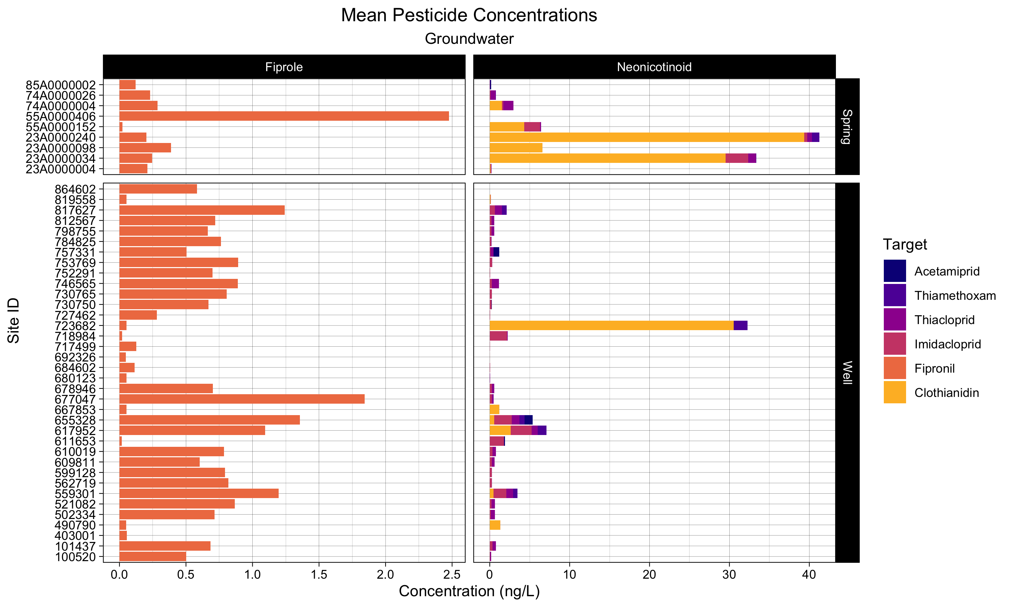
Notes:
Take longer explaining axis’ and graph
Explain logistic models
Switch agricultural and developed.
Explain multiple samples hidden within each dot.

Slide 37
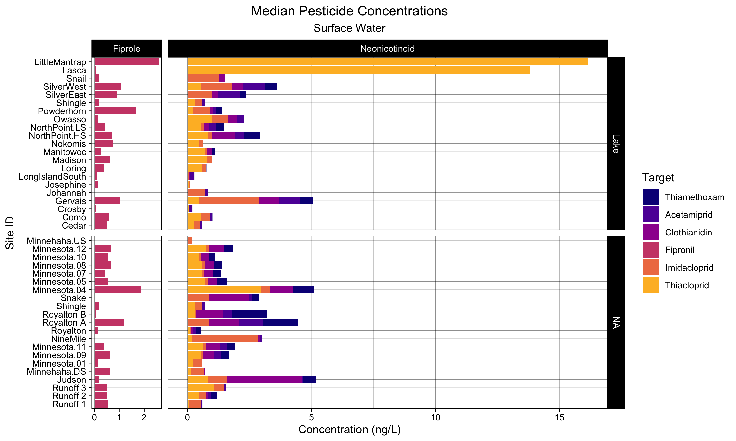

Slide 38









Photo-Oxidation
Agriculture Contamination
Non-Target Organism
Direct Runoff
Systemic Uptake
Target Organism
Groundwater Infiltration
Microbial Degradation
Sorption
Groundwater Conveyance
Hydrolysis
Notes:
Talk about complexities of transport and degradation pathways,
Results in light of complex systems

